Slide 1
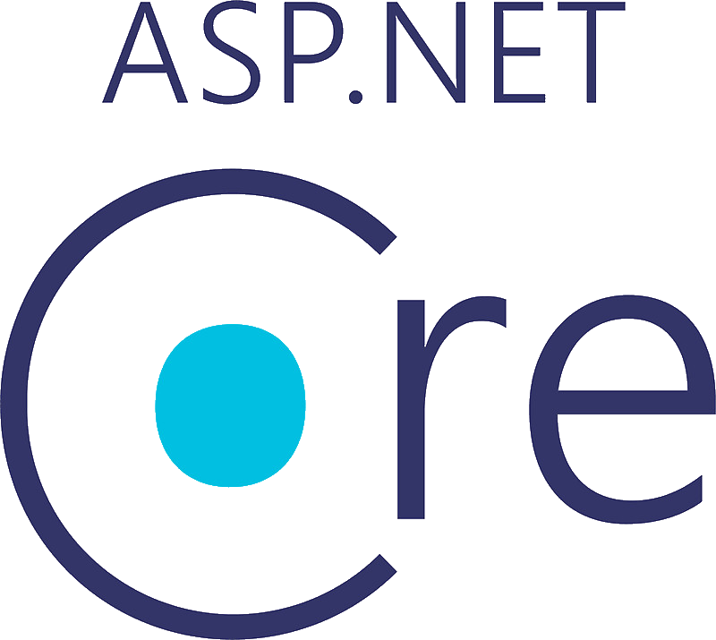
ASP.NET Core 8.0
NAME OF PROJECT: Internet and Web Basics Instructor: Amit Joshi Student: Hakan Ay
Course Link: Udemy Course

Slide 2

Course Objectives
Understand Internet and web fundamentals
Learn to build web applications using ASP.NET Core 8.0
Apply MVC architecture and database integration
Create responsive and secure web applications

Slide 3

About the Course
Total Study Hours: 36 hours 29 minutes
Completed Modules: Basics of Internet, MVC, CRUD, Authentication
Course Link: Udemy Course

Slide 4

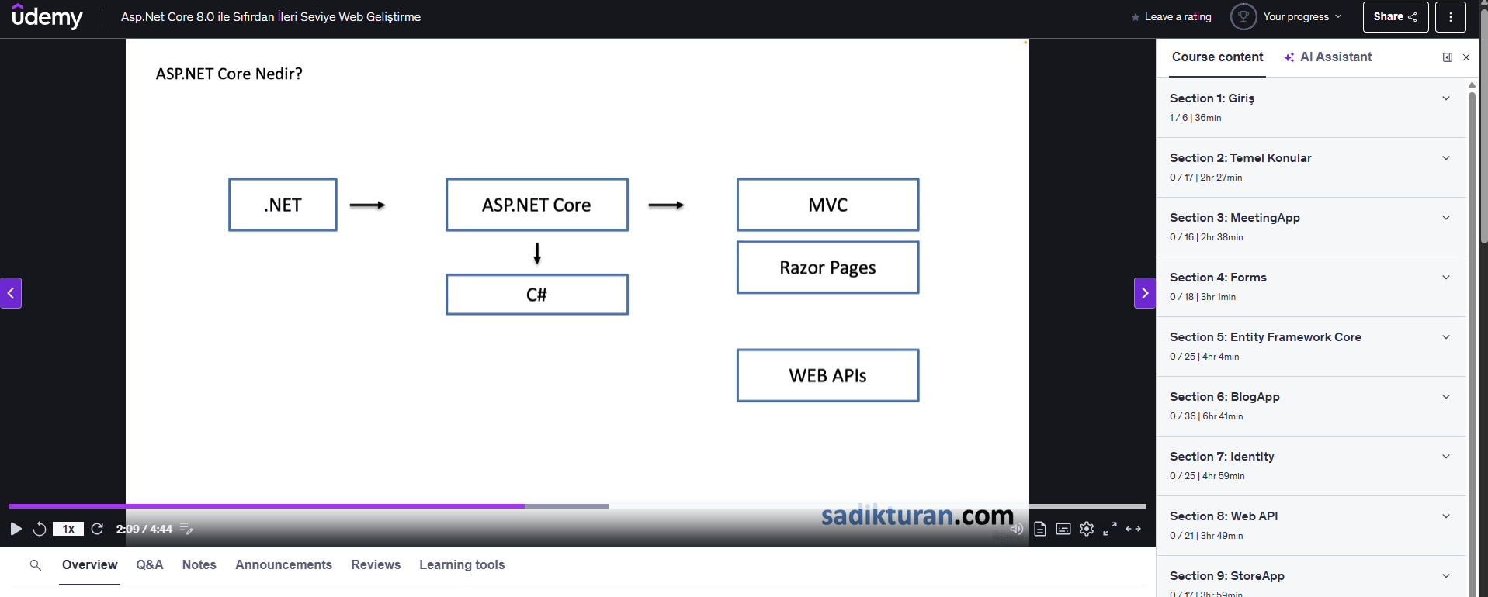
course progress chart

Slide 5

Why I Chose This Course
To learn full-stack web development from scratch
To gain practical skills in ASP.NET Core 8.0
To strengthen career prospects in web development

Slide 6

My Learning Goals
Understand web development fundamentals
Learn how to build a full-stack web application
Develop skills for real-world projects
Prepare for future advanced certifications

Slide 7
Conclusion
This course aligns with my career objectives
It provides a structured path from beginner to advanced
Next steps: Complete the course and apply learned skills in a mini project

